Slide 1
ECE314 Lab 1 Overview
Random variable
Examples
Representations
In Python

Slide 2

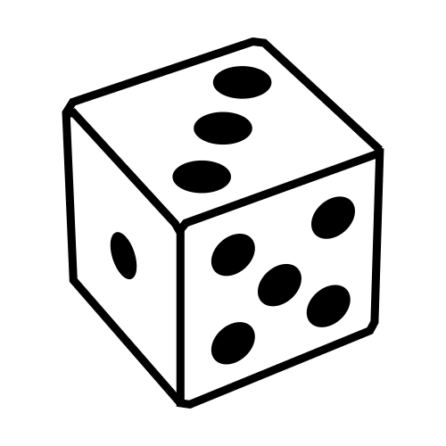

Random variable
A random variable is a variable, the value of which is random.
Examples:
The result of tossing a coin
The result of tossing a dice
Your body temperature at 8:00am tomorrow
discrete
continuous

Slide 3











Random variable: representations
Example: Tossing a fair coin, record 1 if Head, record 0 if Tail. Denote this random variable as $X$.
Table
pmf (probability mass function)
CDF (cumulative distribution function)
$$p\left(c\right)=\operatorname{Pr}{(X=c)}$$
$$F\left(c\right)=\operatorname{Pr}{(X≤c)}$$
c | 0 | 1
p | 0.5 | 0.5
$$1$$
$$0.5$$
$$0.5$$
$$c$$
$$0$$
$$1$$
$$c$$
$$0$$
$$1$$
This is a Bernoulli random variable with parameter 0.5.

Slide 4



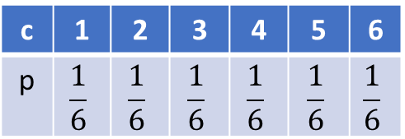










Random variable: representations
Example: Let $X$ denote the result of tossing a dice.
Table
pmf (probability mass function)
CDF (cumulative distribution function)
c | 1 | 2 | 3 | 4 | 5 | 6
p | $$\frac{1}{6}$$ | $$\frac{1}{6}$$ | $$\frac{1}{6}$$ | $$\frac{1}{6}$$ | $$\frac{1}{6}$$ | $$\frac{1}{6}$$
$$p\left(c\right)=\operatorname{Pr}{(X=c)}$$
$$F\left(c\right)=\operatorname{Pr}{(X≤c)}$$
$$?$$
$$\frac{1}{6}$$
$$1$$
$$2$$
$$3$$
$$4$$
$$5$$
$$6$$
$$c$$
$$1$$
$$2$$
$$3$$
$$c$$
$$4$$
$$5$$
$$6$$

Slide 5
Random variable: in Python
Create a random variable as a Python object:
X = scipy.stats.bernoullli(0.5)
c = (1,2,3,4,5,6)
p = (1/6,1/6,1/6,1/6,1/6,1/6)
X = scipy.stats.rv_discrete(values=(c,p))
Python
object
Use an object’s built-in methods:
X.pmf(1)
X.mean()
X.var()

